Slide 1
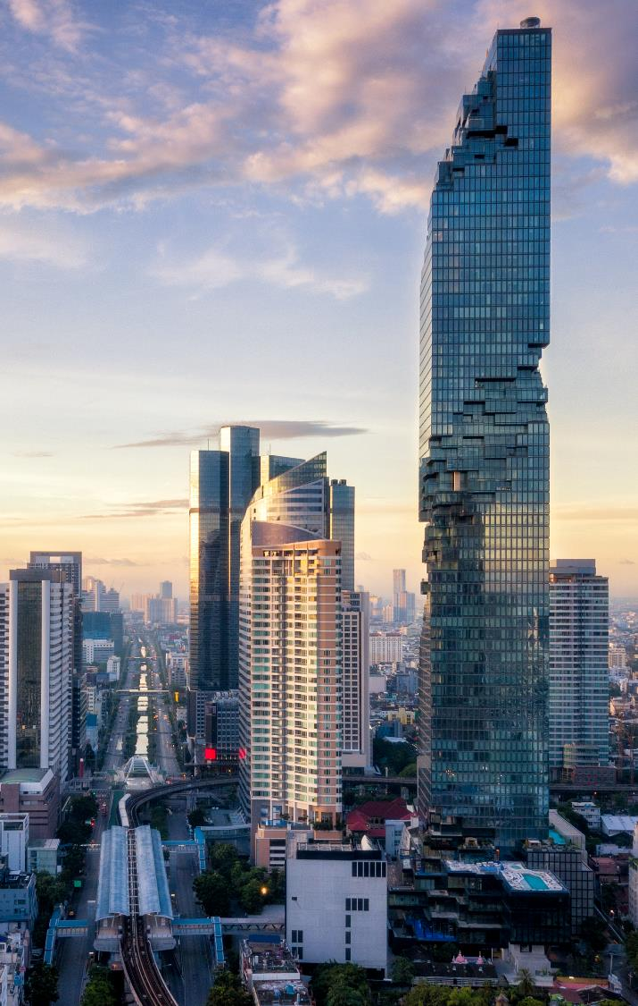
PDF parsing engine using ChatGPT Structured Output
Khunakorn Luyaphan (Gates)
2025-07

Slide 2



High Level View
User Input 9 Fields
AI Input 13 Fields
Extract PDF into specific excel format

Slide 3


New Tool - Structured Output
{ “product_name”: “Flat-leaf Parsley”,
“manufacturer_name”: “Daregal”
}
Created Structured Output in This Format {“product_name” : string,
“manufacturer_name” : string}
Rich Text
{ “product_name”: “EXTER 100 - Bouillon”,
“manufacturer_name”: “Exter B.V.”
}
Created Structured Output in This Format {“product_name” : string,
“manufacturer_name” : string}
Images

Slide 4
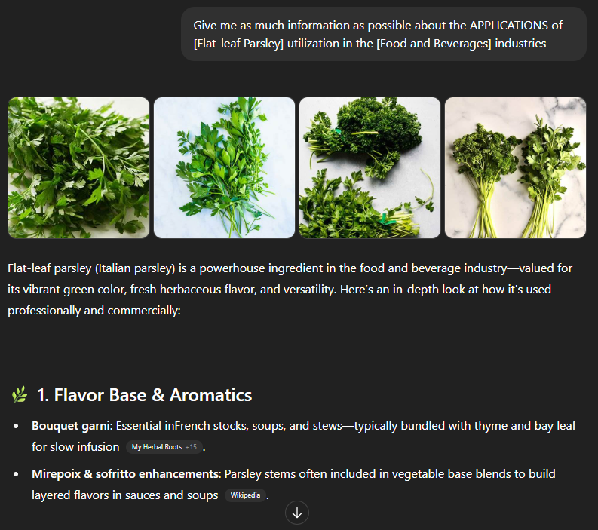
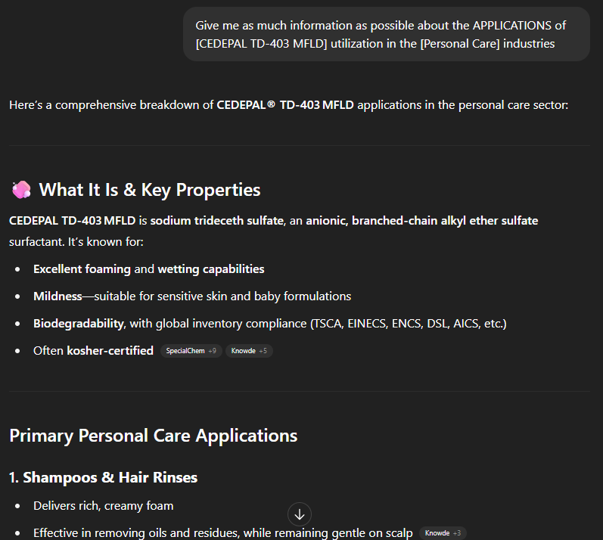
New Tool – GPT Web Search
FBI – Flat-leaf Parsley
PCI – CEDEPAL TD-403 MFLD

Slide 5
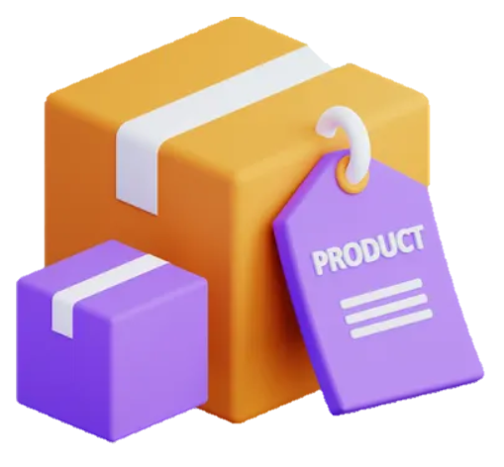



Plan Of Attack
CASE 1
1PDF 1PRODUCT
Supplier
Product1
LlamaParse
Get Text from PDF
ChatGPT4o
List All Products
CASE 2
1PDF MULTI PRODUCT
Azure Document Intelligence
Supplier
Supplier
Get Text from PDF
Product1
Product2
PyMuPDF
Get Images from PDF

Slide 6
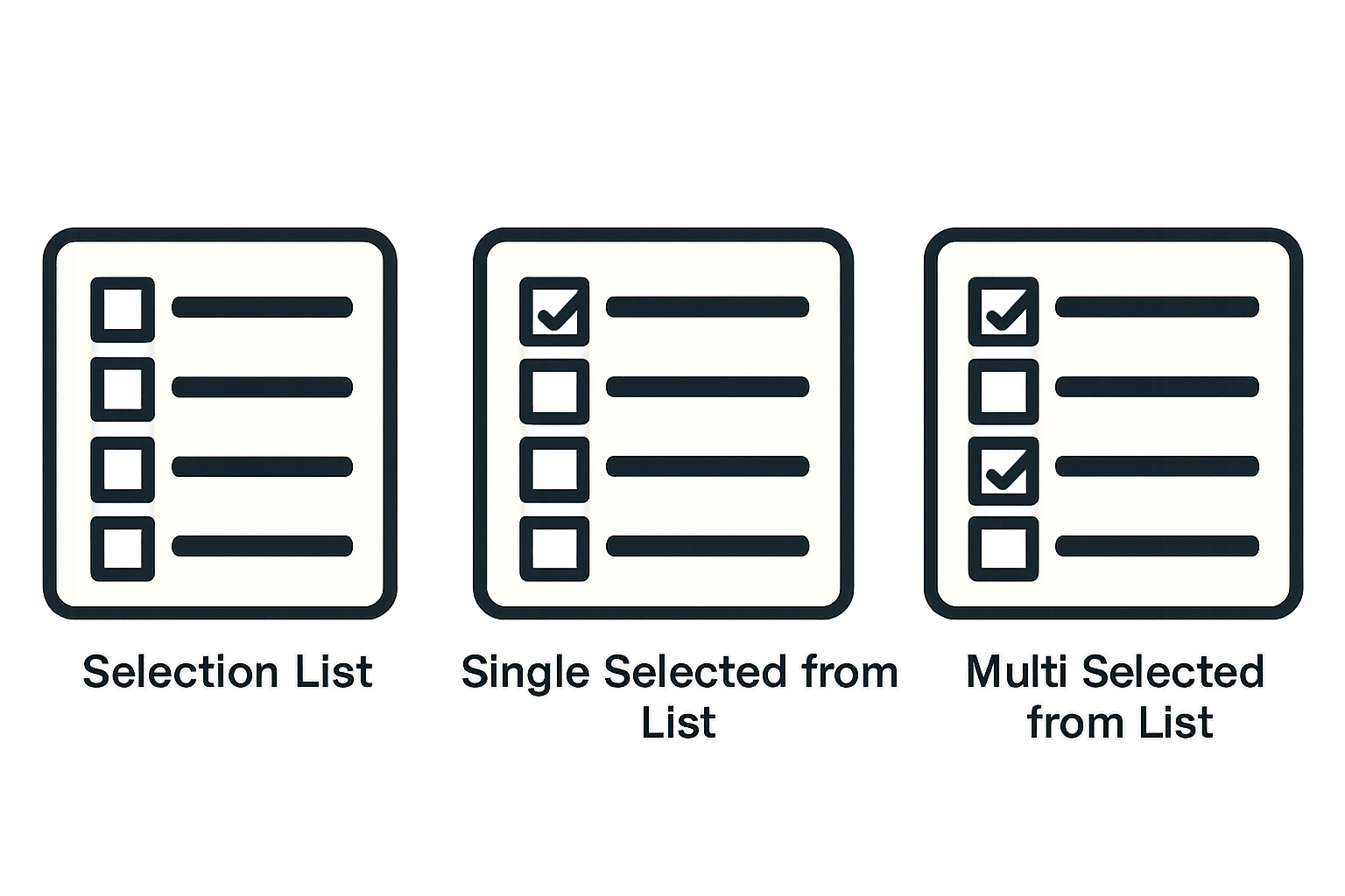
Documents
Web Search
TYPE 0 – Single Return Free Text
Text
“EXTER 100”
Supplier
Supplier
Documents
Get Product Name
Product
Product
Search Results
Images
TYPE 1S – Single Select From List
TYPE 2S – Multi Select From List
Selection list
Selected
Selection list
Selected List
Single Select from list
Multi Select from list
Documents
Documents
TYPE 1WS – Web Search
Then Single Select From List
TYPE 2WS – Web Search
Then Multi Select From List
Data From web search
Data From web search
Selection list
Selected
Selection list
Selected List
Single Select from list
Multi Select from list
Documents
Documents

Slide 7
DEMO

Slide 8
High Level View

Slide 9
High Level View
Extract PDF into specific excel format

Slide 10
High Level View
43 Fields
Extract PDF into specific excel format

Slide 11
High Level View
CASE 1
PRODUCT
PRODUCT
CASE 2
PRODUCT

Slide 12
Plan Of Attack

Slide 13
Plan Of Attack
LlamaParse
Get Text from PDF

Slide 14
Plan Of Attack
LlamaParse
Get Text from PDF

Slide 15
Plan Of Attack
LlamaParse
Get Text from PDF
PyMuPDF
Get Images from PDF

Slide 16
Plan Of Attack
LlamaParse
Get Text from PDF
PyMuPDF
Get Images from PDF

Slide 17
Plan Of Attack
LlamaParse
Get Text from PDF
ChatGPT4o
List All Products
PyMuPDF
Get Images from PDF

Slide 18
Plan Of Attack
Product1
LlamaParse
Get Text from PDF
ChatGPT4o
List All Products
PyMuPDF
Product2
Get Images from PDF

Slide 19
Plan Of Attack
Product1
ChatGPT4o
LlamaParse
Get Text from PDF
ChatGPT4o
List All Products
PyMuPDF
Product2
Get Images from PDF

Slide 20
Plan Of Attack
Product1
ChatGPT4o
LlamaParse
Structured Output
Get Text from PDF
ChatGPT4o
List All Products
PyMuPDF
Product2
Get Images from PDF

Slide 21
Plan Of Attack
Manufacturing address:
Manufacturer Article:
Physical Location:
Composition – Substance:
Composition – Role: …………(total 43 fields)………
Product1
ChatGPT4o
LlamaParse
Structured Output
Get Text from PDF
ChatGPT4o
List All Products
PyMuPDF
Product2
Get Images from PDF

Slide 22
Plan Of Attack
Manufacturing address:
Manufacturer Article:
Physical Location:
Composition – Substance:
Composition – Role: …………(total 43 fields)………
Product1
ChatGPT4o
LlamaParse
Structured Output
Get Text from PDF
ChatGPT4o
List All Products
Manufacturing address:
Manufacturer Article:
Physical Location:
Composition – Substance:
Composition – Role: …………(total 43 fields)………
PyMuPDF
Product2
Get Images from PDF
ChatGPT4o
Structured Output

Slide 23
Thank you for your attention

